Slide 1
29th IAOPA World Assembly Queenstown, NZ March 2018 PBN and the Benefits for GA
IAOPA

Slide 2
PBN and the benefits for GA

Slide 3
IAOPA 29th World Assembly
Performance Based Navigation (PBN) and the Benefits for General Aviation
Our Speakers:
Steve Smyth Director, New Southern Sky, Air Transport and Airworthiness Civil Aviation Authority of New Zealand
Mark Adeane Navigation Procedure Designer Aeropath Ltd / Airways New Zealand
Graham Cheal Manager Aircraft Operations, Airline Technical Support Air New Zealand
Moderator: Andrew Andersen (Australia)

Slide 4
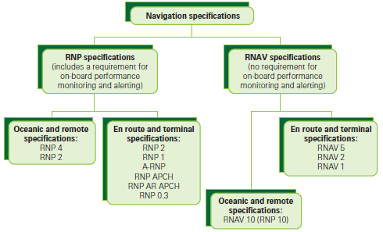
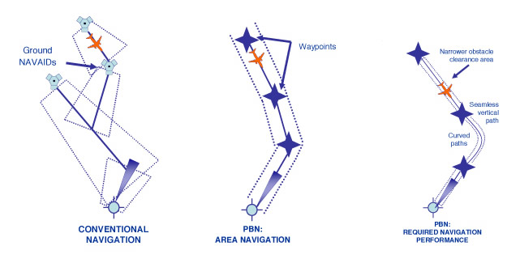
IAOPA 29th World Assembly
(quick recap of the essentials!) Performance Based Navigation Two kinds of specifications:
RNAV (aRea NAVigation)
RNP (Required Navigation Performance)
What’s the fundamental difference between RNAV and RNP? On-board alerting and monitoring. => a more robust version of RNAV => additional routes, greater capacity.

Slide 5
IAOPA 29th World Assembly
Performance Based Navigation Potential Benefits: Why do this?
Cautions for GA:
Avionics requirements:
Many IFR GA are TSO C129a equipped
CDI scaling differs between TSO C129a and TSO C146
Issues with SIDs and STARs in some countries
Ground-based navaid rationalisation
Pilot instrument ratings, training and transition arrangements
Operational approvals.
Increased capacity, especially for airlines and major airports:
Can be good for GA too, with equitable airspace policies
Could even allow more airspace for VFR, depending on policy
Achievable transition pathway from RNAV
Depends on sensible policies for avionics standards and requirements
Could facilitate route structure improvements
Remove dependency on ground-based navaids, reduced distances
Specialist ops advantages (for example, RNP 0.3 low helicopter routes)
Calculation of lowest safe altitudes
Technology neutral
But satellite-navigation-friendly (better than terrestrial route structures)
Contains and integrates APV (LNAV/VNAV, LPV)
Standardised procedures internationally.

Slide 6
IAOPA 29th World Assembly
Performance Based Navigation (PBN) and the Benefits for General Aviation
Steve Smyth Director, New Southern Sky, Air Transport and Airworthiness Civil Aviation Authority of New Zealand

Slide 7
IAOPA 29th World Assembly
Performance Based Navigation (PBN) and the Benefits for General Aviation
Mark Adeane Navigation Procedure Designer Aeropath Ltd / Airways New Zealand

Slide 8
IAOPA 29th World Assembly
Performance Based Navigation (PBN) and the Benefits for General Aviation
Graham Cheal Manager Aircraft Operations, Airline Technical Support Air New Zealand

Slide 9
IAOPA 29th World Assembly
Performance Based Navigation Panel and Audience Questions and Discussion Points
Most GA IFR pilots will never fly “AR” approaches, but they have, or will soon be, converting from terrestrial and previous RNAV specifications. What are the key points for IFR GA pilots to consider as they make the transition?

Slide 10
IAOPA 29th World Assembly
Performance Based Navigation Panel and Audience Questions and Discussion Points
Most GA IFR pilots will never fly “AR” approaches, but they have, or will soon be, converting from terrestrial and previous RNAV specifications. What are the key points for IFR GA pilots to consider as they make the transition?
What can GA pilots learn from the transition made by airline crews to new navigation technology?

Slide 11
IAOPA 29th World Assembly
Performance Based Navigation Panel and Audience Questions and Discussion Points
Most GA IFR pilots will never fly “AR” approaches, but they have, or will soon be, converting from terrestrial and previous RNAV specifications. What are the key points for IFR GA pilots to consider as they make the transition?
What can GA pilots learn from the transition made by airline crews to new navigation technology?
New Zealand and Australia are jointly trialling SBAS technology as we speak. What would be the key safety and efficiency benefits for GA, and the aviation industry more generally?

Slide 12
IAOPA 29th World Assembly
Performance Based Navigation Panel and Audience Questions and Discussion Points
Most GA IFR pilots will never fly “AR” approaches, but they have, or will soon be, converting from terrestrial and previous RNAV specifications. What are the key points for IFR GA pilots to consider as they make the transition?
What can GA pilots learn from the transition made by airline crews to new navigation technology?
New Zealand and Australia are jointly trialling SBAS technology as we speak. What would be the key safety and efficiency benefits for GA, and the aviation industry more generally?
The PBN nav specs are standardising some concepts that were previously disjointed and so there are benefits in procedure design, nomenclature and presentation. How can other forms of standardisation - setting personal weather minimums; choosing quality, standardised training; and adopting custom approach checklists and briefings be used to make IFR approaches more consistently safer and efficient? What can we apply from PBN generally, and RNP Approach (including AR) procedures in particular, to leverage IFR flight safety for GA?

Slide 13
IAOPA 29th World Assembly
Performance Based Navigation Panel and Audience Questions and Discussion Points
Most GA IFR pilots will never fly “AR” approaches, but they have, or will soon be, converting from terrestrial and previous RNAV specifications. What are the key points for IFR GA pilots to consider as they make the transition?
What can GA pilots learn from the transition made by airline crews to new navigation technology?
New Zealand and Australia are jointly trialling SBAS technology as we speak. What would be the key safety and efficiency benefits for GA, and the aviation industry more generally?
The PBN nav specs are standardising some concepts that were previously disjointed and so there are benefits in procedure design, nomenclature and presentation. How can other forms of standardisation - setting personal weather minimums; choosing quality, standardised training; and adopting custom approach checklists and briefings be used to make IFR approaches more consistently safer and efficient? What can we apply from PBN generally, and RNP Approach (including AR) procedures in particular, to leverage IFR flight safety for GA?
As our countries implement PBN, what are the key messages for GA, pertaining to enroute, terminal and approach modes of flight for pilots to consider?

Slide 14
IAOPA 29th World Assembly
Performance Based Navigation Panel and Audience Questions and Discussion Points
Thank you for your participation.

